Slide 1
Modern Front End applications

Slide 2

About me
Started Front End development in 2009;
Graduated VGTU in 2014 (Bachelor’s Degree. Engineering informatics);
Professionally developing Front End applications for more than 5 years;
Domas Makšimas
Lead Front End developer @Visma Lietuva
Notes:
Hi! My name is Domas Makšimas, I’m lead front-end developer in one of the product teams at Visma Lietuva. Today we are going to talk about front end development and modern front end applications in particular. A little bit of information about myself: I started learning front-end development back in the 2009, I started with simple websites which didn’t required lots of skills. In the meantime I graduated VGTU and been developing front-end applications professionaly for over 5 years.

Slide 3
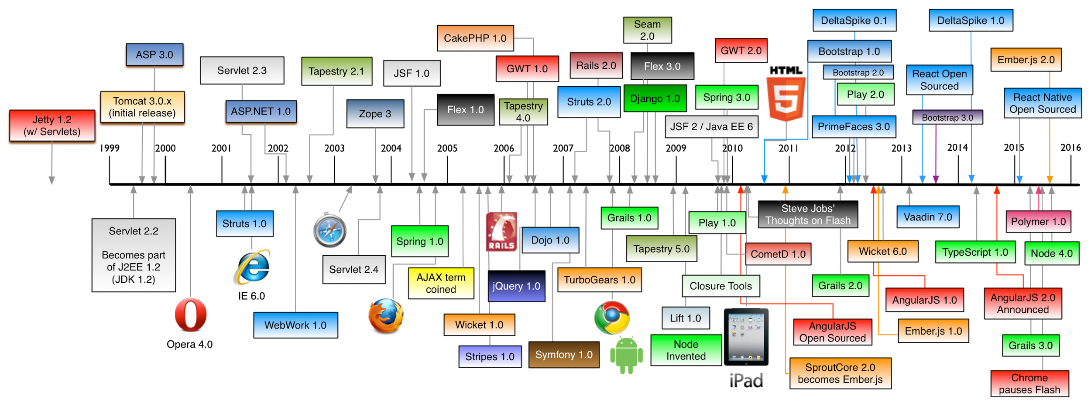
Web development history
https://github.com/mraible/history-of-web-frameworks-timeline/blob/master/history-of-web-frameworks-timeline.png
Notes:
During that time front-end development changed drastically, so let’s go through main point in history which led us to what we have today.
Late 1990 - Tim Berners-Lee specified HTML with it’s wapping 18 tags definition.
In 1995 - JavaScript saw daylight after just 10 days of development
In 1996 - CSS was initially released but we didn’t think of it too much back then..
Nothing crucial happened up until 2009 when NodeJs was invented. Ecosystem started to build up, new standards started to emerge. People got excited..

Slide 4

HTML Geolocation
HTML Drag and Drop
HTML Local Storage
HTML Application Cache
HTML Web Workers
HTML SSE
HTML Service Workers
and more..
Notes:
One of the main skills for front end developer to master is the knowledge of HTML5. HTML5 is a W3C Recommendation which was released in 28 October 2014. It introduced specifications for new features and elements. Most popular APIs are listed in the slide. These features allows developers to build more interactive, user friendly web applications.

Slide 5

Geolocation example
https://jsfiddle.net/hsaugw3o/2/

Slide 6



Animations
Gradients
Flexbox
Box-model
Media queries
SASS
LESS
OOCSS
SMACSS
BEM
Notes:
We can’t imagine web applications without nice styles. They provide visual flow for user, helps keep your eyes on important part of applications. Earlier, writing maintainable CSS was impossible, however, the times when we put everything into one main.css file is over and we should never look back. Tools like SASS and LESS helps us write modular, maintainable CSS styles. Moreover different methodologies like OOCSS, BEM and SMACSS helped us rethink how css should be treated.

Slide 7
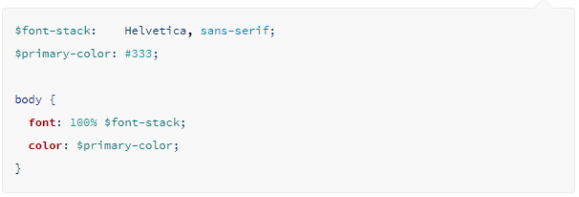
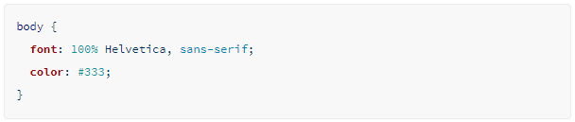
SASS features: variables

Slide 8
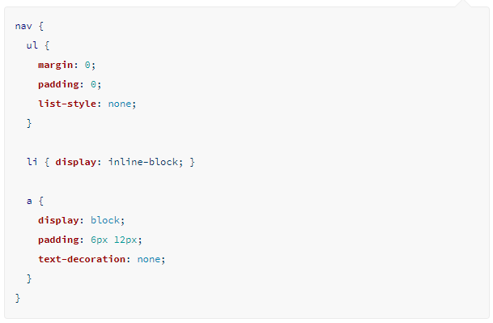
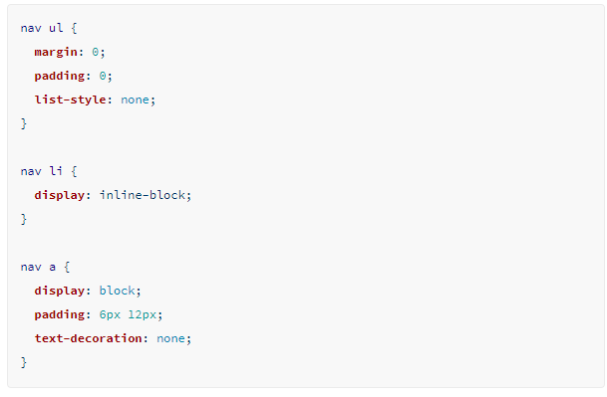
SASS features: nesting

Slide 9
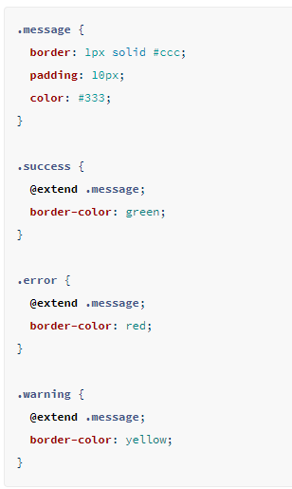
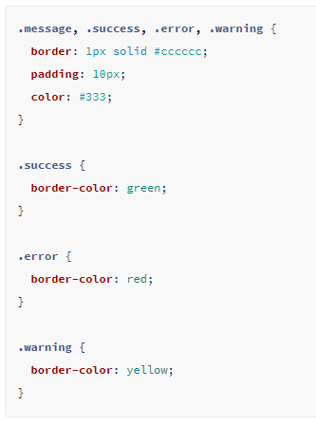
SASS features: extend/inheritance

Slide 10
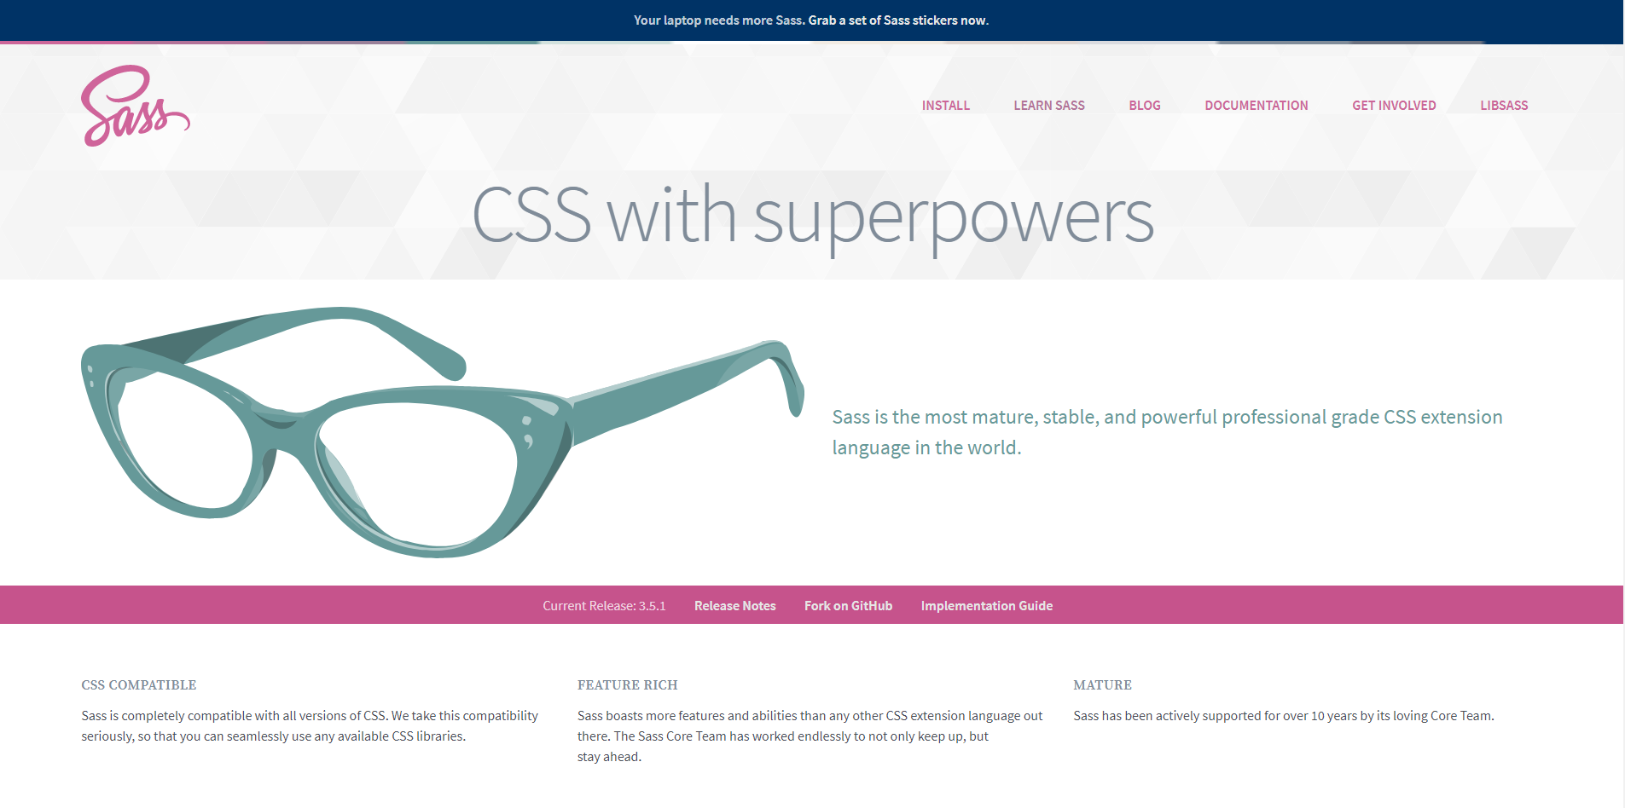
@media (max-width: 699px) and (min-width: 520px)
http://sass-lang.com/

Slide 11

ECMAScript releases
June 1997
June 1998
December 1999
December 2009
June 2011
June 2015
June 2016
June 2017
Notes:
But the most important aspect of modern front end applications are offcourse javascript. Without javascript we wouldn’t have any interactions with the users. Javascript gives us ability to react to user inputs, make applications dynamic. Javascript history is full of bumps. First released in 1997 after few years of development it stalled for 10 years, and only in 2009 it was rethought and until now 5 versions were released during that 8 year period. And the future is bright here - different browser vendors collaborate to create and implement new features so that we, developers would be able to create better functionality for end users.

Slide 12
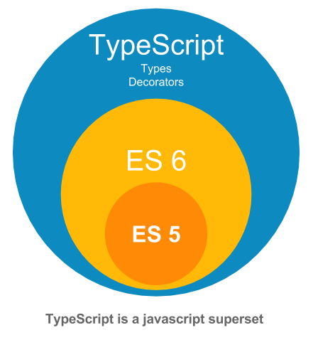
Everything is a superset
ES5 - http://es5.github.io/
ES6 - https://git.io/es6features
ES7 - http://bit.ly/es7features
TS - https://www.typescriptlang.org/
Notes:
So after ECMAScript stagnated for a while, community started to go ahead and rethink Javascript. Microsoft, for example, came up with a new “language” called TypeScript. It included new standard implementations and typehinting and it transpiled to other versions of ecmascript so it can be used for all applications without thinking about compatibility issues. And the best part is that all new versions of ES and TypeScript for example is a superset of previous version. There are other solutions for having new javascript features ready to use (alternatives to typescript) for example Babel, of FlowJS for typehinting. And these technologies were adapted rapidly, for example TypeScript is used to create frameworks like Angular, FlowJs is used together with ReactJS..

Slide 13
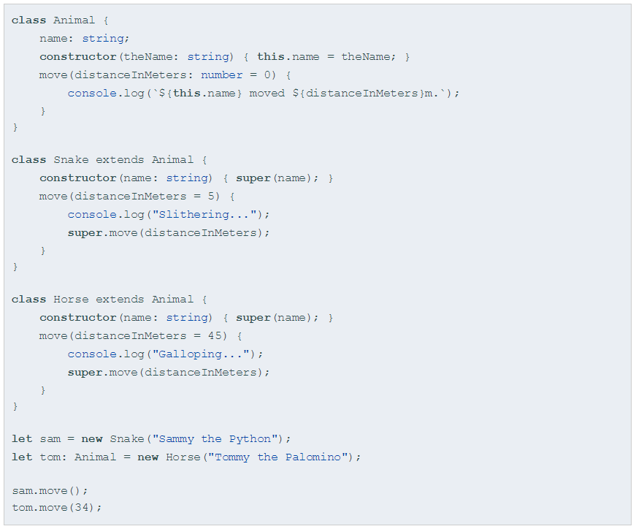
TypeScript class example

Slide 14

Node.js® is a JavaScript runtime built on Chrome's V8 JavaScript engine.
Notes:
You may notice that I mentioned a lot of different tools which are built around native front-end technologies. It makes developer life easier, and nothing of this could be possible without NodeJs. NodeJs was released in 2009 and it allows to run javascript on server side, that means it can run in CLI too. This allowed developers to build a lot of tools and automate a lot of tasks. Together with NodeJS, npm was founded, and it’s the largest ecosystem of open source libraries in the world

Slide 15
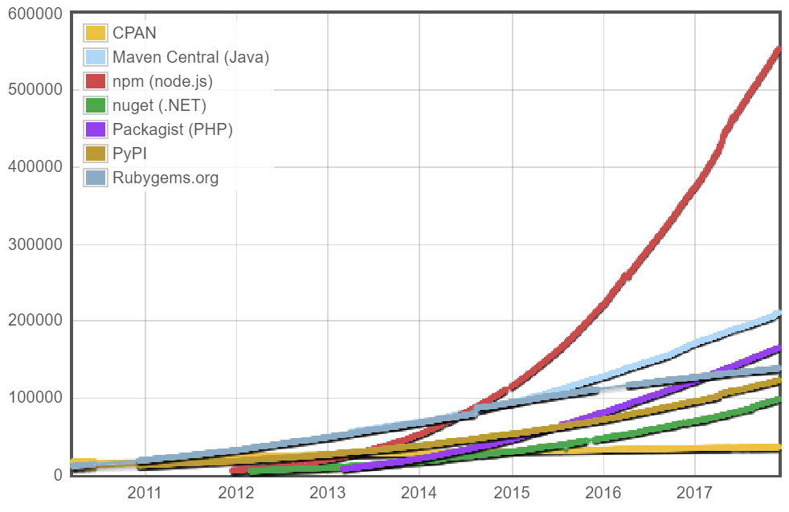

Notes:
As you can see it has almost no competition, with about 600k packages now with a average growth of 500 per day. All of these tools and technologies allows us to build modern front-end applications

Slide 16


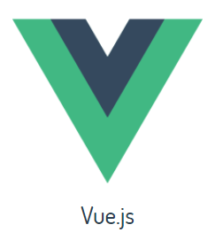
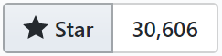
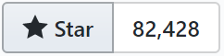
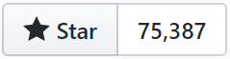
Notes:
When we are talking about modern front end applications, currently there are 3 main options for frameworks you can choose. All of them are opinionated, all of them have its pros and cons and some of them are not even called a framework (hint reactjs). Popularity for these so called frameworks are different, and they are mostly used in different applications. Angular and react is developed by big industry guys - angular is developed by Google and reactjs is developed by facebook, where vue.js started as framework by the community. No matter what you choose, all of them are have something in common.

Slide 17
They are all written in JavaScript
sort of..
Notes:
They are all written in JavaScript.. Sort of..

Slide 18
TypeScript
JSX
JavaScript
Notes:
Angular is written with typescript, reactjs template syntax is called jsx and seems like only vue.js is actually vanilla js… Anyway, they are still have something in common. For example, all of these frameworks embraces component based architecture

Slide 19
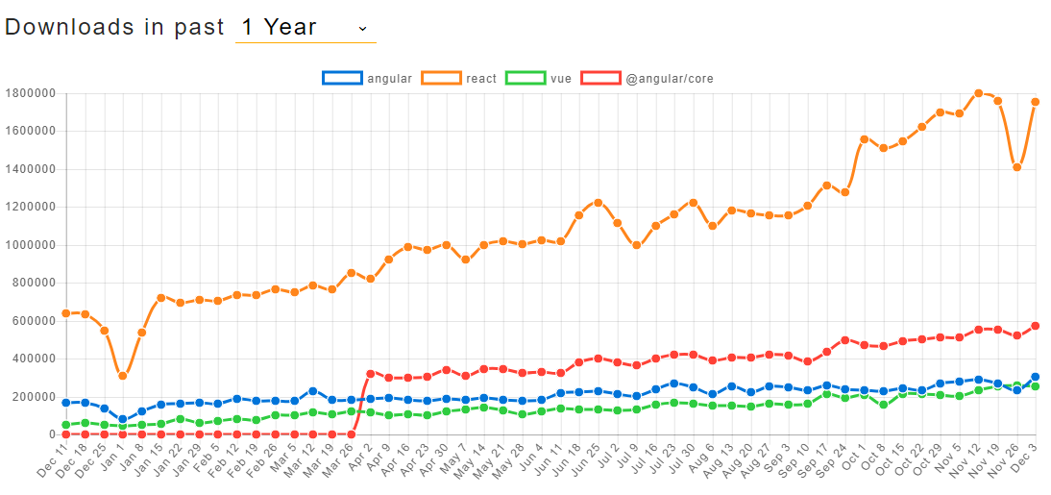
Trends
http://www.npmtrends.com/angular-vs-react-vs-vue-vs-@angular/core

Slide 20
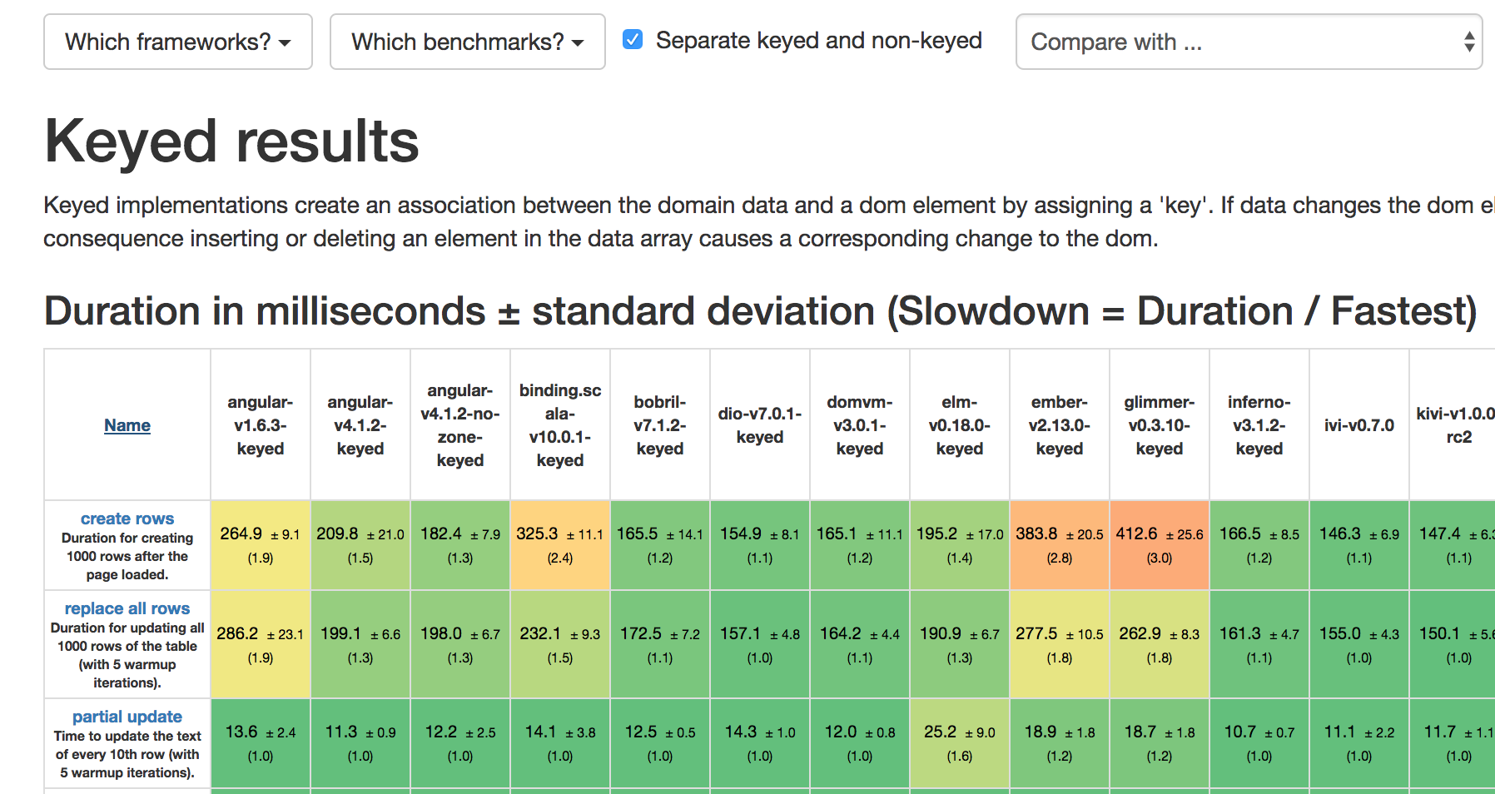
Performance
https://rawgit.com/krausest/js-framework-benchmark/master/webdriver-ts-results/table.html

Slide 21

Component based architecture
Notes:
The component system is an important concept, because it’s an abstraction that allows us to build large-scale applications composed of small, self-contained, and often reusable components. If we think about it, almost any type of application interface can be abstracted into a tree of components. Components replaced commonly used MVC pattern.
You can think of a component as a small feature that makes up a piece of the user interface. If I were to describe a component within the scope of Facebook’s UI, A chat window would be a component, a comment feed would be another component, and a constantly updating friend list would represent yet another component.
Each of these components exist within the same space, yet interact independently from one another. Components have their own structure, their own methods and their own APIs. Components are also reusable and can be “pasted” into interfaces at will. The independent nature of components allows for developers to create a UI with many different moving parts.

Slide 22
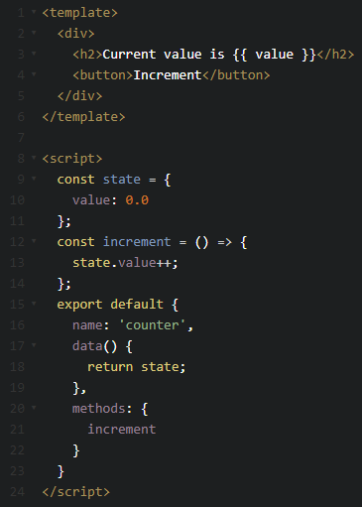
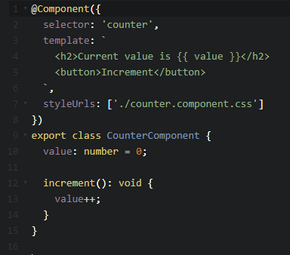
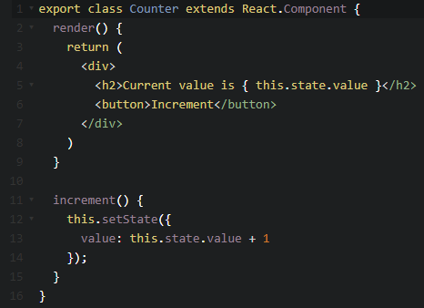
Comparison

Slide 23
Modular JavaScript
Simplifying dependency management
Code Organization: let us divide up functionality of our application, provide encapsulation
Offers code reusability
Decoupling (easing pain in refactoring)
Code Extensibility
Notes:
JavaScript began as a language for building small scale websites; but today, websites are becoming web applications and code bases and functionality are growing to be larger. Developers needed a way to separate functionality and simultaneously specify dependencies. Languages like C++ and Java rely on external libraries such as as a math library to compute basic math equations without having to rewrite them. So libraries enable languages to not repeat code and delegate functionality and this is similar to what modules gives JavaScript. Modules help developer’s separate functionality and organize the codebase. One of the largest reasons for modules is JavaScript’s global namespace which can become easily polluted. Functions are the only thing in JavaScript that create a new scope; thus anything not declared within a function is apart of the global namespace. Thus every function we declare in JavaScript is available globally and therefore its name cannot be used again. Often this leads to a polluted namespace where names and code can be difficult to find and reuse. But sometimes we don’t want that function to be available everywhere. In order to make functions in one JavaScript file available to just a single other JavaScript file, we can use modules. Although there are many other reasons, the top reasons for modular capabilities are:

Slide 24


Typehinting
Notes:
As you can see, javascript aims to be fully featured high-level language, like for example C#. Different tools and techniques were used to add notion of datatypes for javascript, beginning with JSDocs, where types were noted in annotations. Now Typescript and FlowJS are mostly used tools for providing datatypes for javascript. Other languages like C++ or Java have something called type checking, during a compilation phase it first checks for some simple mistakes in the code and raises an error if it finds any. These tools also performs type checking.

Slide 25
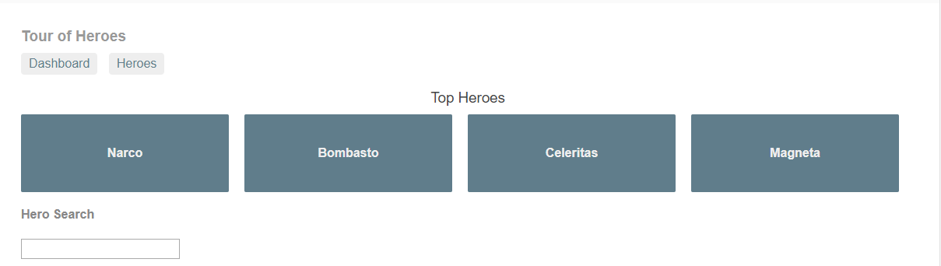
Angular application example
https://embed.plnkr.co/qv1JyzmKvydWZHPKC8NG/

Slide 26



Testing
Notes:
Same as in other programming languages, to write quality code you need to write tests, mainly unit tests. We can use couple of tools for this like mocha, jest, jasmine and all of them widely used. Jasmine is better for BDD and mocha is more suitable for TDD. Jest fits both. As more and more code of business logic is transferred to front end, it is essential to ensure integrity of your application and unit tests helps to achieve this.

Slide 27
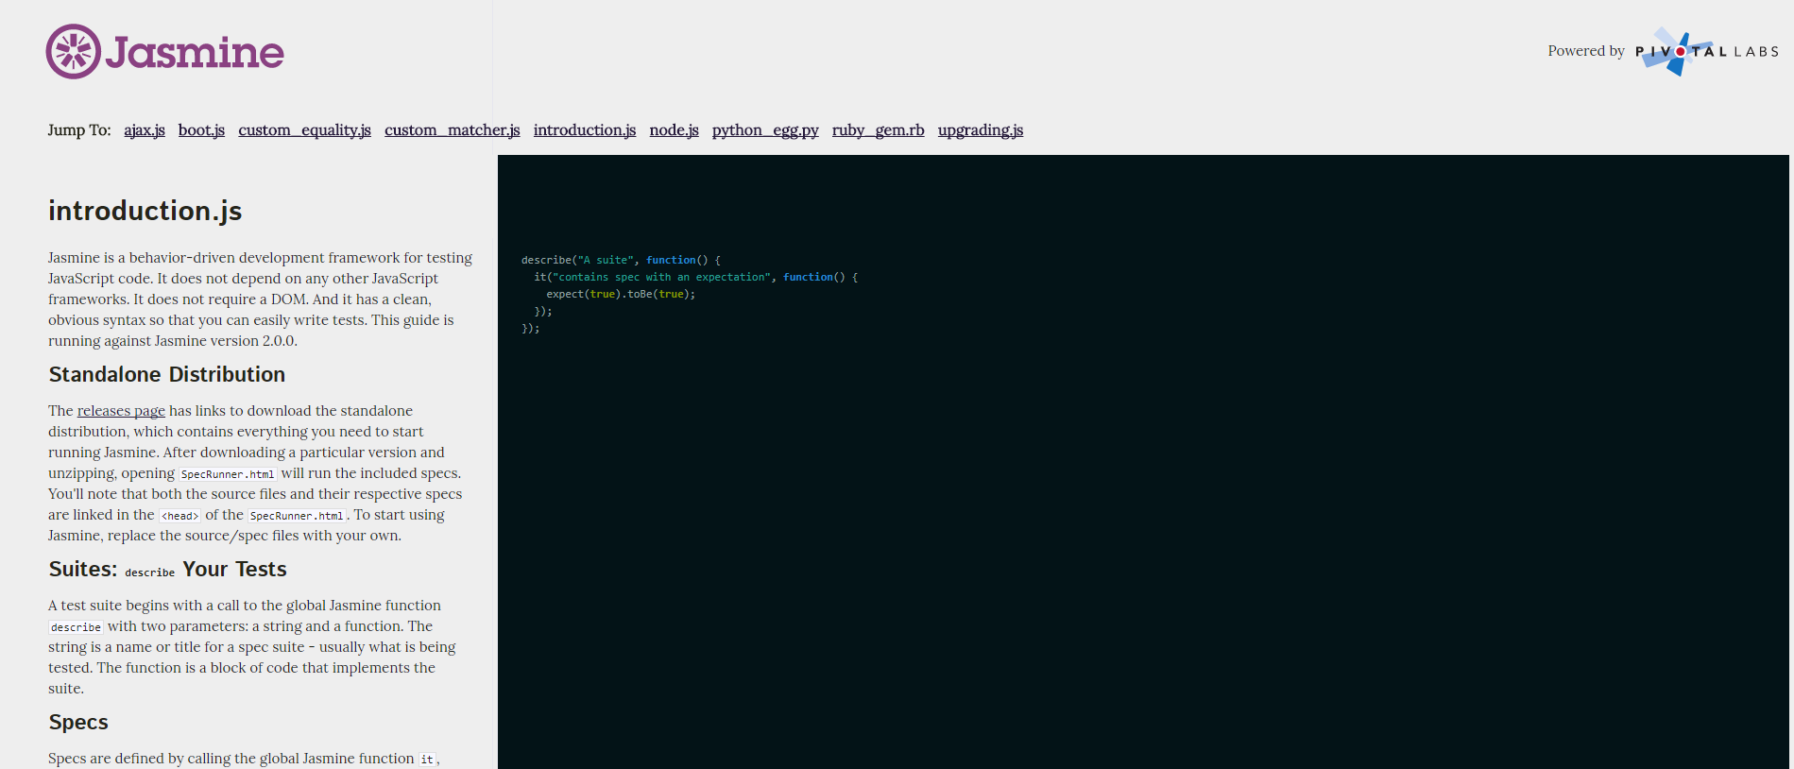
Jasmine example
https://jasmine.github.io/2.0/introduction.html

Slide 28



Building
Notes:
While using front end frameworks, there is a lot of code end user might never use, if we provide this code to the user, page load times might increase and user experience would be impact in a bad way. And as always, we have solution for that too. Well, a couple of them.. And again, all of them have different features, pros and cons

Slide 29
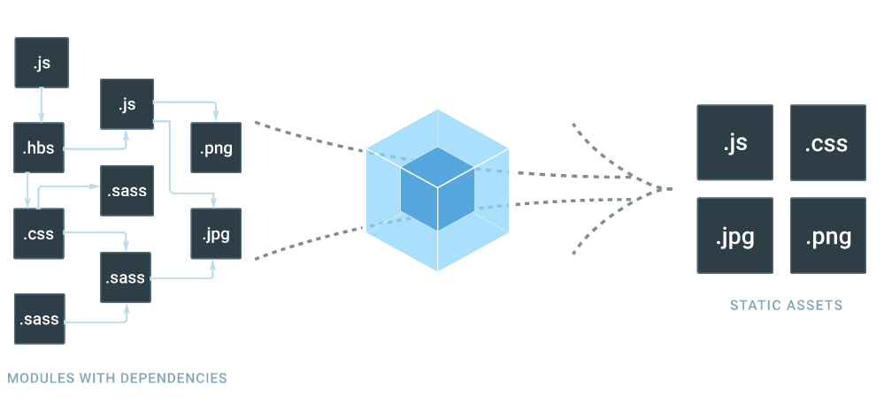
Webpack
Notes:
Webpack is probably the most powerful one, and a lot of people are using this for optimizing bundle sizes of final application. It has cool features like treeshaking, codesplitting, analyzer and others.. The down side is that it’s quite slow.

Slide 30

https://xkcd.com/303/

Slide 31
Programming principles
SOLID
DRY
KISS
YAGNI
TDD/BDD
and many more..
Notes:
When building modern front end applications we should do it in the same way if we would be building any modern application, we should base our decisions on best programming principles.. Just to name a few. Front end development shouldn’t be treated differently compared with other applications development. All the same principles and best practices apply. The times where we put all functionality to one file making it impossible to maintain is far over, and over the time we will see that front end development will inherit all other good practices and features from all other languages.

Slide 32
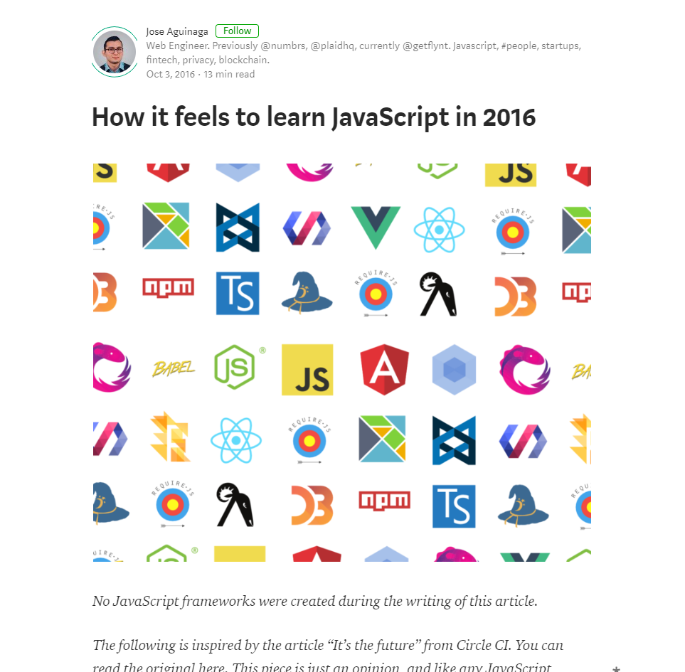
Bunch of new stuff..
https://hackernoon.com/how-it-feels-to-learn-javascript-in-2016-d3a717dd577f
Notes:
And things got out of hand. Numerous libraries, tools and frameworks were developed, people divided into different camps. Standards were created and adapted.. But not all of them..

Slide 33
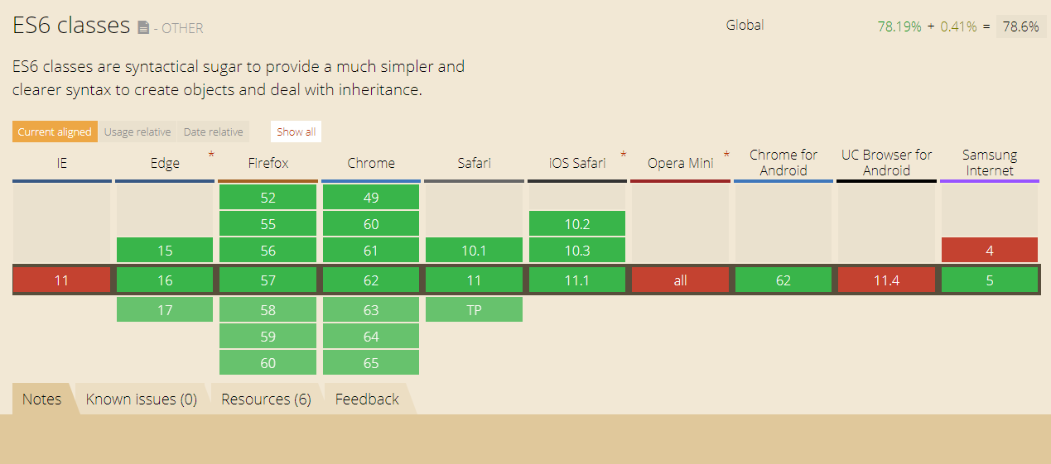
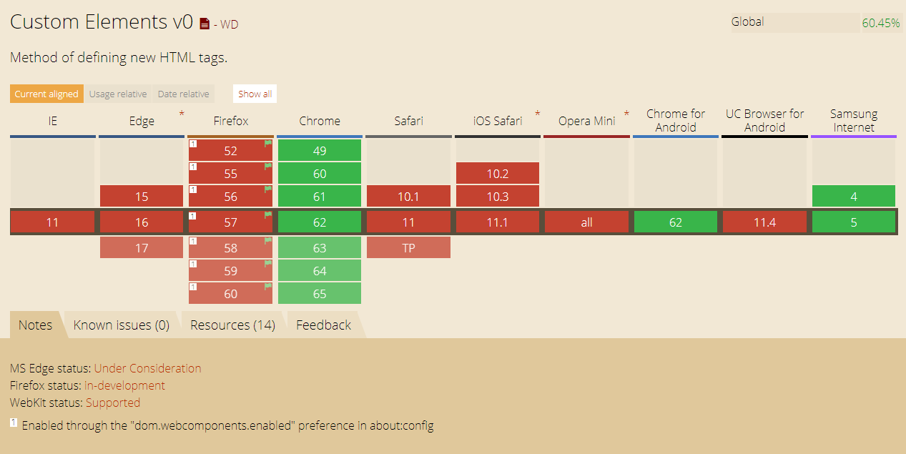
https://caniuse.com/
Notes:
..

Slide 34

What Is a Front End Developer
Front-end web development, also known as client-side development is the practice of producing HTML, CSS and JavaScript for a website or Web Application so that a user can see and interact with them directly. The challenge associated with front end development is that the tools and techniques used to create the front end of a website change constantly and so the developer needs to constantly be aware of how the field is developing.
https://frontendmasters.gitbooks.io/front-end-handbook-2017/what-is-a-FD.html
Notes:
Front-end web development is an exciting career because it’s always evolving and constantly changing. This means you’ll always have the opportunity to interact with new tools and learn new skills, keeping you engaged in your career. It’s a field that provides many opportunities for hands-on learning. But good front end developers not only tries new stuff, they also are aware of best programming practices and they are able to use them with new technologies. And this field grow even more.

Slide 35
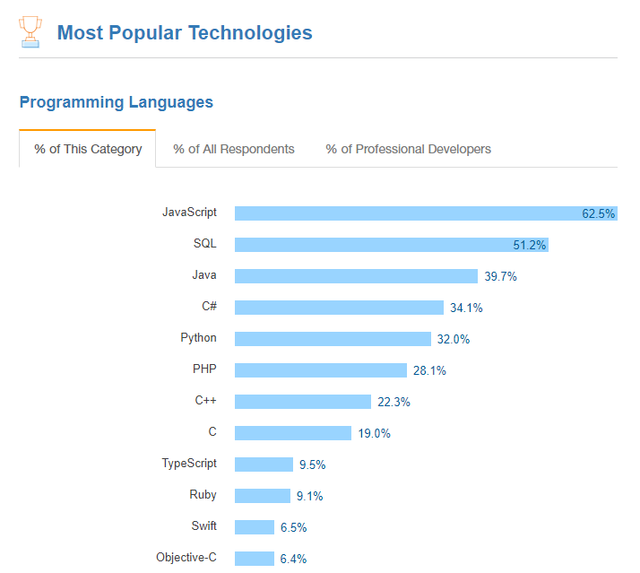
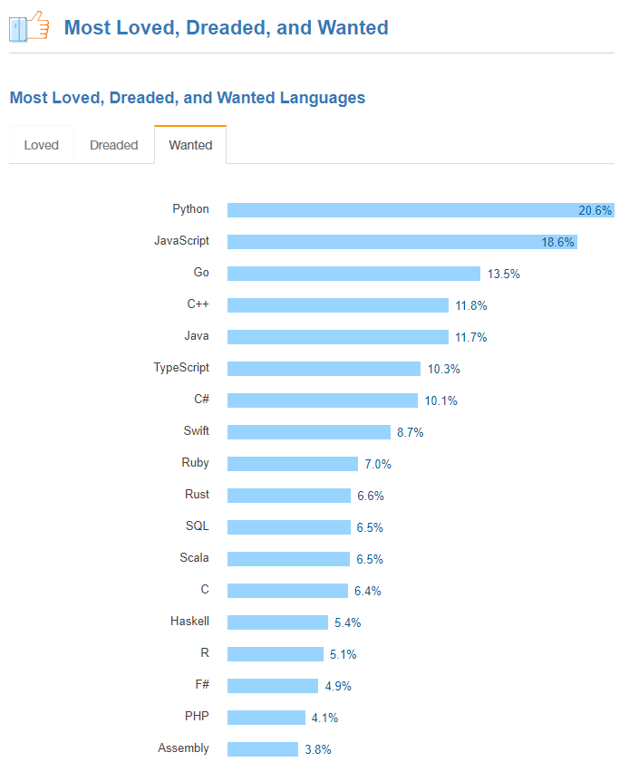
https://insights.stackoverflow.com/survey/2017
Notes:
Annual StackOverflow survey asked 64k developers what is their mostly used programming language and JavaScript took more than 62% of the answers. And when asked what technologies they want to learn, 18% responded that they wanted to learn Javascript. So no matter what you want to do - be a back-end developer, full-stack or front-end - javascript and front-end technologies are thing that every developer should have up his sleeve.

Slide 36


